Slide 1
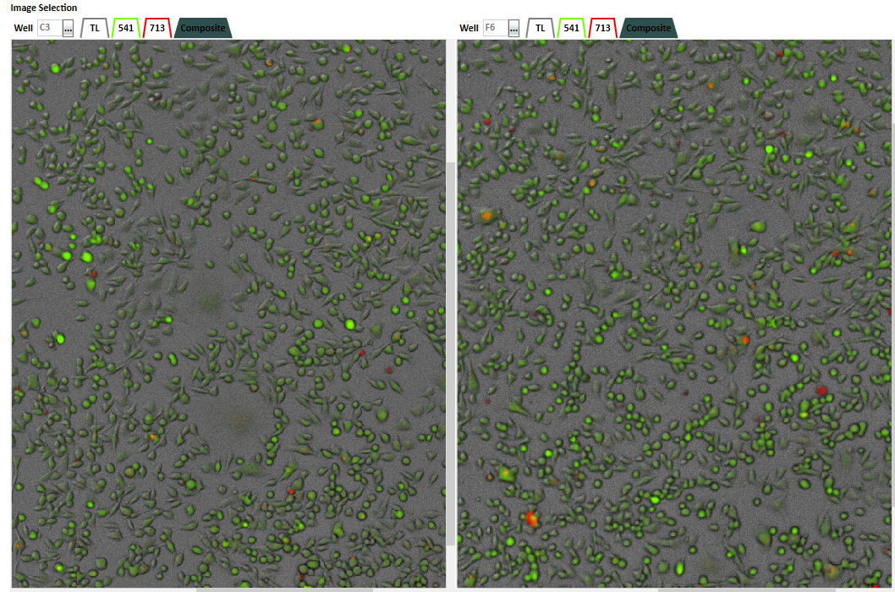
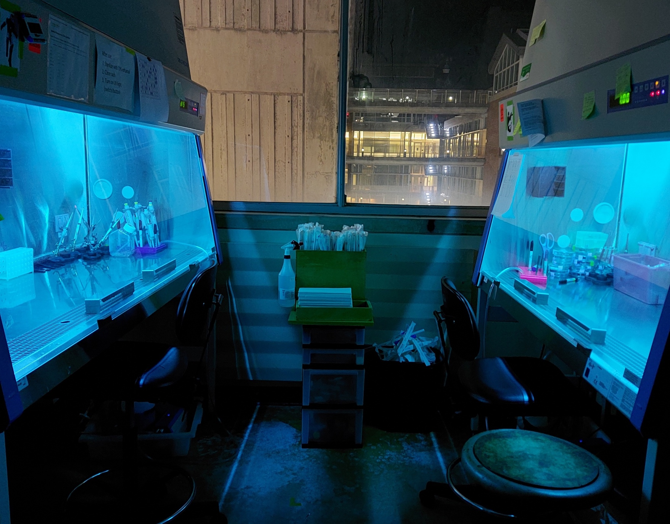
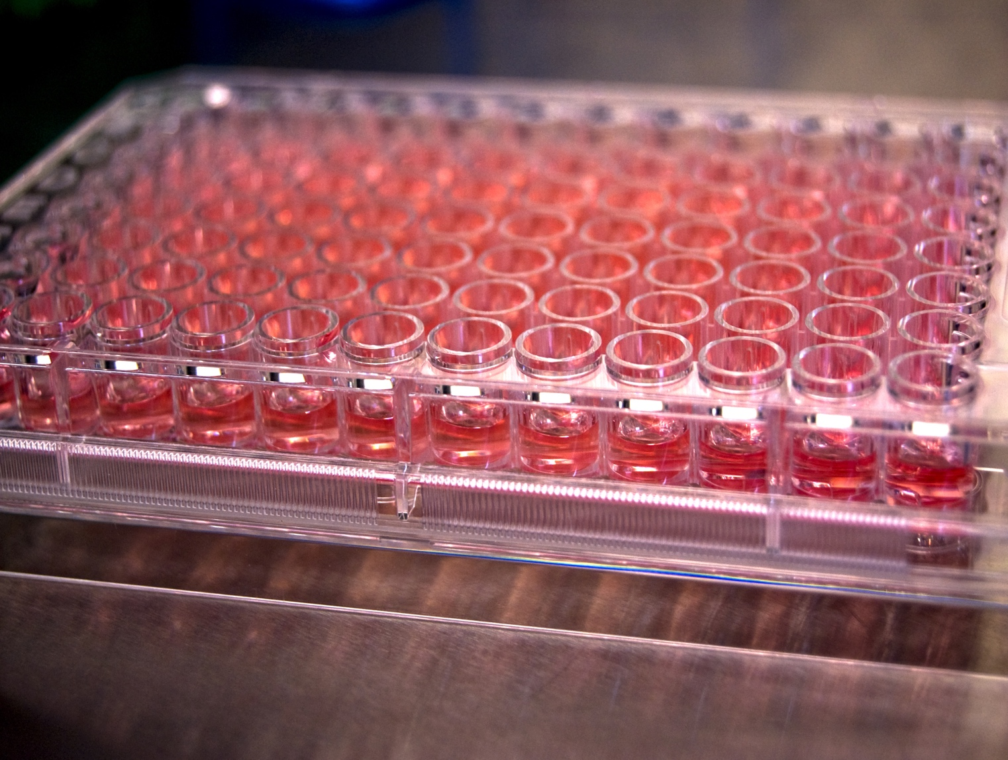
PFAS toxicity and cancer cell proliferation William Dennis – B.S. Chemistry – Biochemistry Dr. Matthew Lockett – Chemistry Dept.

Slide 2
Objective/Hypothesis
Goal – discover if PFAS molecules:
Using the M231 (triple negative breast carcinoma line), determine if per- and polyfluoroalkyl substances (PFAS)
Effect cell proliferation over a 6-day period in
Purpose:
To identify which PFAS have acute toxicities, allowing us to narrow the window of concentrations tested in future studies
To determine if PFAS molecules increase proliferation (i.e., promote tumor growth)
Have acute toxicity
Increase reactive oxygen species and oxidative stress after a 48h exposure
To identify PFAS molecules that cause oxidative stress, to direct future studies focused on the mechanism of action

Slide 3
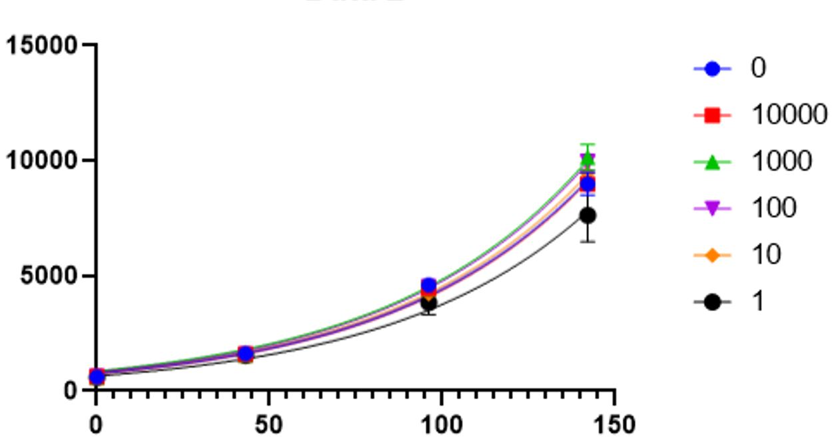
Results
The results of a t-test (using fraction of live over total cells) show that there is no significant change in cell viability (no toxicity).
One of the four growth curves is shown (PFOA), which yields no significant change in cell growth over varying toxicities.
T.test result | PFOA | PFOH | PFOS | GENX
1 nM | 0.083 | 0.470 | 0.420 | 0.177
10 nM | 0.089 | 0.219 | 0.126 | 0.154
100 nM | 0.290 | 0.464 | 0.098 | 0.068
1000 nM | 0.062 | 0.217 | 0.059 | 0.081
10000 nM | 0.060 | 0.043 | 0.026 | 0.054
Lowest value | 0.060 | 0.043 | 0.026 | 0.054
PFOA concentration (nM)
Number of hours
The results of the toxicity screen ensure that there will be no interference of toxicity in future assays. The growth curves are complete; however, they need to still be reviewed. Soon, we will see whether the growth curves yield changes in doubling time due to changes in PFAS concentration.

