Slide 1
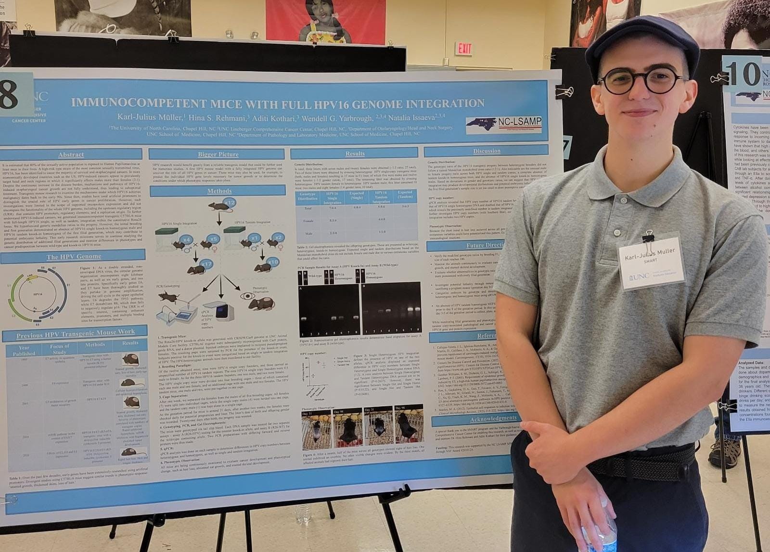
Immunocompetent mice with full hpv16 genome integration
Karl-Julius Müller
Biology B.S., Rising Senior
Yarbrough/Isaeva Lab
Dpt. Of Otolaryngology/ Head and Neck Surgery
Lineberger Comprehensive Cancer Center
PI: Dr. Wendell Yarbrough, Dr. Natalia Isaeva
Mentors: Aditi Kothari, Dr. Hina Rehmani

Slide 2
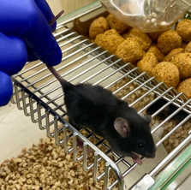
DOES THE GENETIC DISTRIBUTION OF HPV16 TRANSGENIC MICE FOLLOW A CLASSIC MENDELIAN RATIO?
A Mendelian monohybrid cross ratio between heterozygotes is typically 1:2:1 for a filial generation.
However, if HPV16 monohybrids produce offspring with modified ratios, we are potentially witnessing a correlated lethality. Thus, we could further study the factors involved in lethality.

Slide 3
Genotype Distribution | HPV16 Single Integration | Expected (Single) | HPV16 Tandem Integration | Expected (Tandem)
Total | 7:6:4 | 4:8:4 | 5:5:0 | 3:6:3
Female | 5:3:4 |  | 4:4:0
Male | 2:3:0 |  | 1:1:0
A first filial generation shows modified ratios: an absence of tandem integrated KI homozygous mice, and lack of single integrated KI homozygous males.
The F1 sample size is too small to be significant. However, we will continue breeding F1 mice. HPV research would benefit significantly from a reliable transgenic model that could be further used for numerous studies.
Persisting modified ratios introduce grounds to study HPV16-associated lethality. This emphasizes the risks of the world’s most sexually transmitted disease. Hopefully, it encourages the general audience to get vaccinated.

