Slide 1
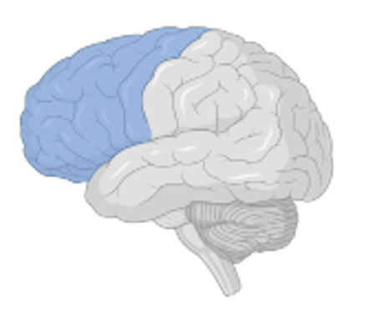
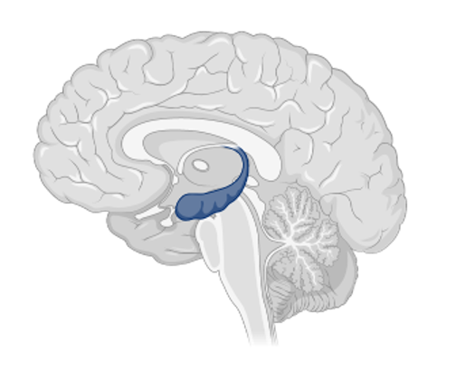
Alcohol Misuse: Motives and Consequences
Danielle Owens, Gracie Elliot, Charlotte Boettiger | UNC Chapel Hill Neuroscience | SMART
Alcohol Misuse
Binge Drinking
Pattern of alcohol consumption that is defined as 4 drinks in two hours for a female or 5 drinks in two hours for a male.
Alcohol Related Blackout
Memory loss caused by high volume of alcohol consumption in a short period of time.
Fragmentary: partial blackout, some memories may be able to be recalled
En Bloc: total blackout, absolutely no memory
Drinking Motives
Created by M. Cooper in 1994
Questionnaire establishes four motives that can be further characterized as positive or negative.
Positive
Social
Enhancement
Negative
Coping
Conformity
Binge drinking leads to diminished cognitive function due to a disturbance in the activity of the prefrontal cortex. ​
Blackouts are defined by a disruption in the hippocampus which is primarily responsible for memory encoding and transferring memories to long term storage.​
​​
Consequences

Slide 2
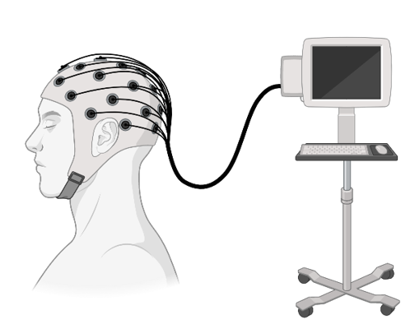
Our Experiment
445 participants aged 18-73 with a racial and ethnic demographic representative to that of the United States.
Participants took the CAUQ to establish the rate of binges in the past year and the ARBQ to establish the total amount of alcohol related blackouts in the past year (fragmentary and en bloc) as well as the Drinking Motives Questionnaire to find each participant's primary domain.
Participants of a similar study underwent an EEG and variables were compared.
Testing Brain Function
EEG: electroencephalogram
Determines brain function by measuring electrical activity in the brain. The EEG net contains 128 electrodes that communicate via electric impulses.
Theta
Delta
Alpha
Beta*
Spectral Power = power ÷ wavelength
In simple terms: the lower the spectral power, the lower the function of the region.
Wave Types:
Hypothesis
Positive drinking motives (social and enhancement) would lead to higher rates of alcohol misuse and a decrease in spectral power in the beta bands of the EEG.

Slide 3
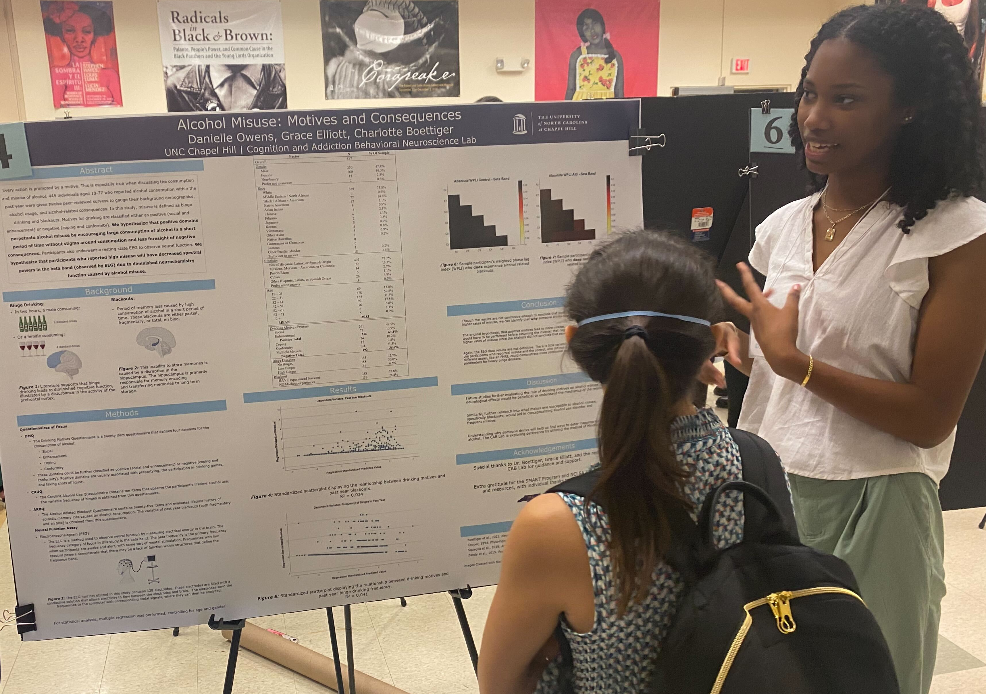
Results
Based on the data from our participants, positive drinking motives did not lead to higher reported rates of misuse. In fact, there was a very slightly significant relationship between negative motives and reported rates of misuse.
The EEG data also proved that there was no significant decrease in spectral powers of the beta bands between the control (no misuse) and reported misuse groups.
Discussion
Future studies further evaluating the role of drinking motives on alcohol misuse and neurological effects would be beneficial to understand the mechanics of the relationship.​
Similarly, further research into what makes one susceptible to alcohol misuse, specifically blackouts, would aid in conceptualizing alcohol use disorder and frequent misuse.​
Understanding why someone drinks will help us find ways to deter inappropriate usage of alcohol.

