Slide 1
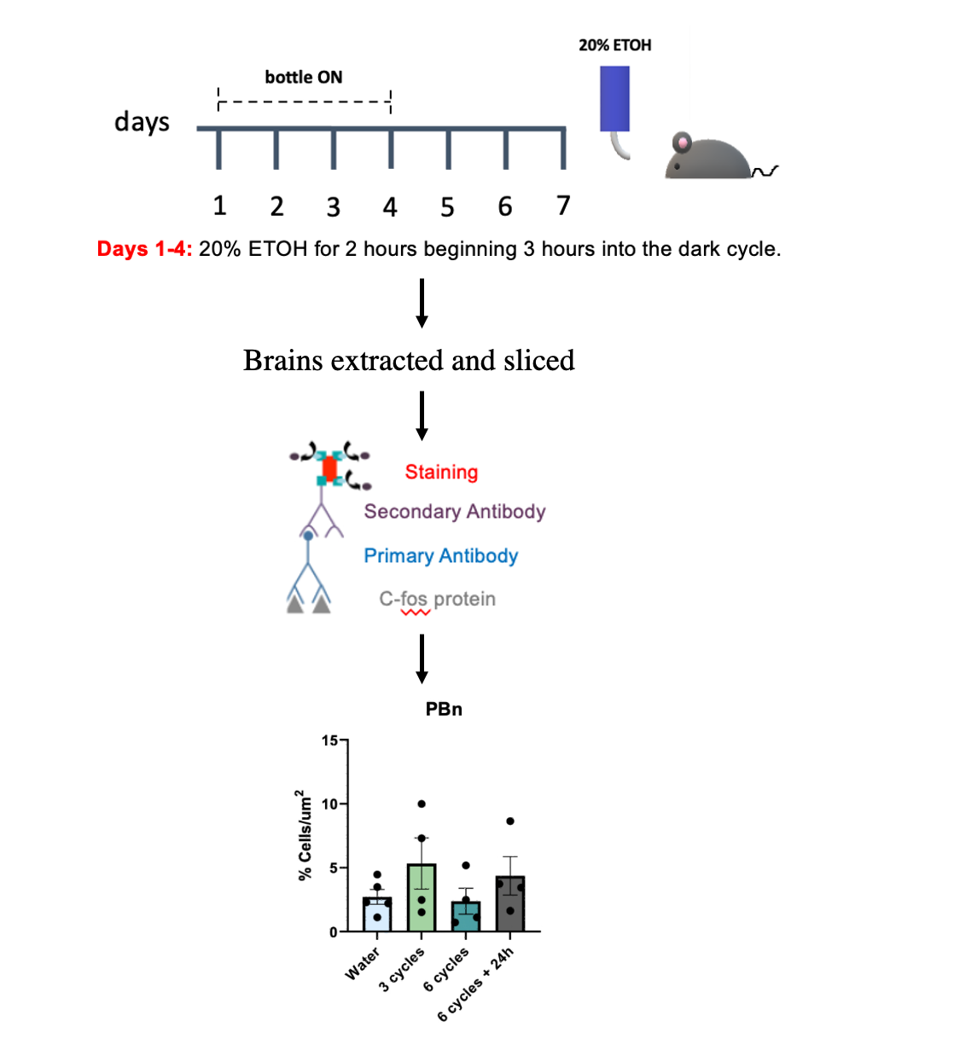
Function of the parabrachial nucleus in regulating aversion to alcohol
Roxana Puig Vazquez
Biology Major
Ana Paula S. Dornellas (PhD) and Montserrat Navarro (PhD)
Department of Psychology and Neuroscience

Slide 2
Research Question:
What happens to the activity of the parabrachial nucleus when mice are exposed to different cycles of binge alcohol drinking?
Why is it important?
This work presents a new insight into the fields of addiction to alcohol, by providing new area of interest involved in the process of regulating alcohol intake and focusing on aversion pathways. Such information can be valuable when developing new drugs and therapies to treat Alcohol Use Disorders.

Slide 3
Results:
Our preliminary results indicate that increasing cycles of drinking in the dark (mimics human binge drinking) reduce the activity of the parabrachial nucleus (PBn) compared to a moderate number of cycles.
Continuous binge intake of alcohol is the cause of such decrease in the activity of the PBn, and that these changes are reversible.
relevance FOR SCIENTIFIC COMMUNITY AND GENERAL AUDIENCE
This study sheds a light on how the brain reacts to large amounts of alcohol in short periods of time and how prolonged exposure to such large amounts of alcohol can decrease its ability to provoke an aversive response and therefore increasing chances of addiction.
These results reveal that interrupting binge drinking cycles reactivates the aversion pathways. Using this knowledge, my research community can experiment with drugs that may have a similar effect to the aversion pathways of the PBn, which can potentially lead to a significant decrease in the amount of drinking in mice.

