Slide 1
Characterization of Human Immune Cell Development in a Next-Generation Humanized Mouse Model
Hannah-Marie Santos
Neuroscience & Women’s and Gender Studies Double Major, Chemistry Minor
Faculty advisors: J. Victor Garcia, Angela Wahl Bench mentor: Sarah Wessel
Division of Infectious Diseases

Slide 2
What is our hypothesis?
Our hypothesis is that human tissue and stem cells can engraft into immunodeficient mice and develop a human/mouse chimera model that supports replication of human-specific pathogens to investigate critical aspects of host/pathogen interactions and test novel pre-clinical interventions.
Why does this even matter?
Highly relevant pathogens, like HIV and MERS, cannot be researched using conventional animal models, which prevents progress of novel interventions that could benefit millions of people worldwide. Developing a mouse model that can properly simulate a human immune system to study these pathogens could pave the way for future pre-clinical approaches.

Slide 3
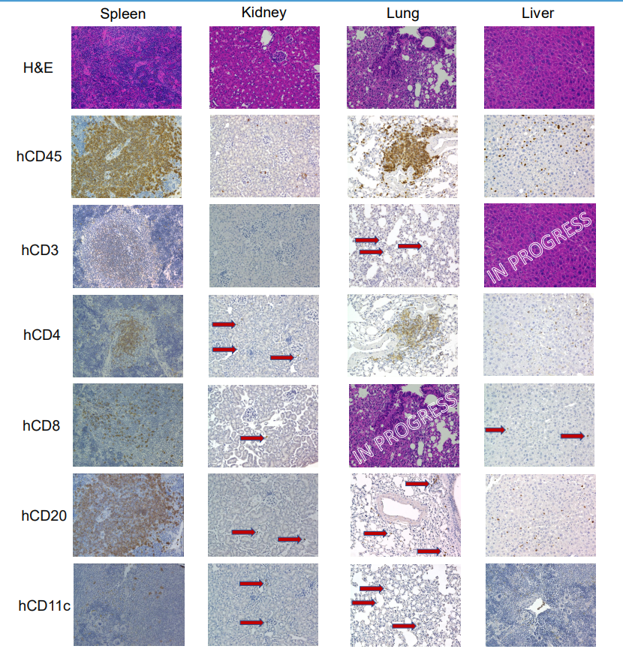
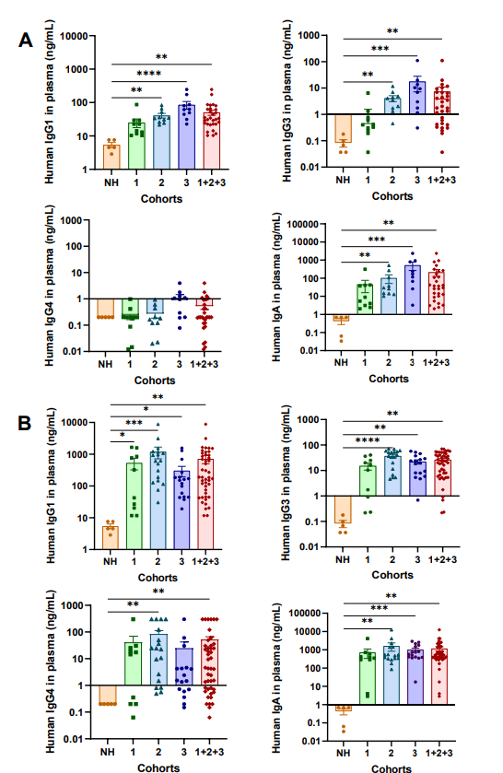
Results & Importance
Immunohistochemistry photos of spleen, kidney, lung, and liver. We identified the amount and location of certain markers: human hematopoietic cells (hCD45), T cells including helper (hCD4) and killer (hCD8) T cells, B cells (hCD20), NK cells (hCD56), and dendritic (hCD11c). Every tissue presented has humanized cells shown by the presence of hCD45. There are less humanization levels in the kidney and liver tissues, since the hematopoietic stem cells only are transferred through blood flow confirming the healthy status of the mice. There were no NK cells (hCD56) in any of the tissues stained. Every photo was taken at 20x magnification
What are our results?
Our results are the immunohistochemistry photos and immunoglobulin graphs on the right. The immunohistochemistry photos show how well the four tissues humanized and where specific cells are. The immunoglobulin graphs show the production levels as time goes on and how significant they are compared to the non-humanized mice control. They support the conclusion that the transplantation of human tissue and hematopoietic stem cells results in the reconstitution of a human immune system in immunodeficient mice.
Why are our results important to your scholarly or research community?
The results show how the development of certain human cells are appearing in the mouse’s tissues, which allows scientists to compare how well this model simulates a human immune system.
Why are our results important to a general audience?
Like stated before, the results from this project will support the overall goal of creating a mouse model that can allow researchers to develop pre-clinical approaches.
Human immunoglobulin levels in plasma (A) 4 months and (B) 5-8 months post-surgery. The IgG2 (>30,000 ng/mL) and IgM (>2,500 ng/mL) levels were above the standard curve threshold. The human immunoglobulin levels increased overtime. A Kruskal-Wallis test was evaluated. Key: * p < 0.05, ** p < 0.01, *** p < 0.001, **** p < 0.0001

