Slide 1
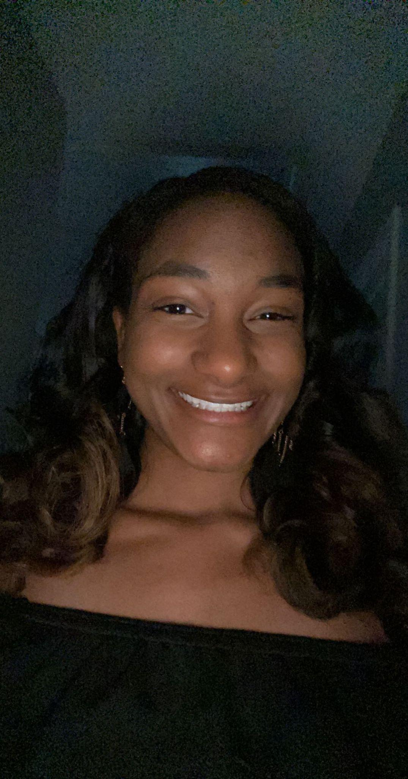
Stranger Things: Genetic Sensitivities to Alcohol
Lindsay Watson
PI: Scott Parnell
Bowles Center for Alcohol Studies UNC Chapel Hill

Slide 2
What is My Project?
Our lab uses a mouse model of Fetal Alcohol Spectrum Disorders to mimic human birth defects caused by prenatal alcohol exposure
The goal of this project was to investigate the role of genetics in prenatal alcohol sensitivity
2 strains of mice were used as the basis of this project
C57BL/6J mice, which are highly susceptible to alcohol related birth defects
129S1/SvImj mice, which are resistant to alcohol related birth defects
This project sought to cross the two strains and compare the rate and severity of defects in the offspring

Slide 3
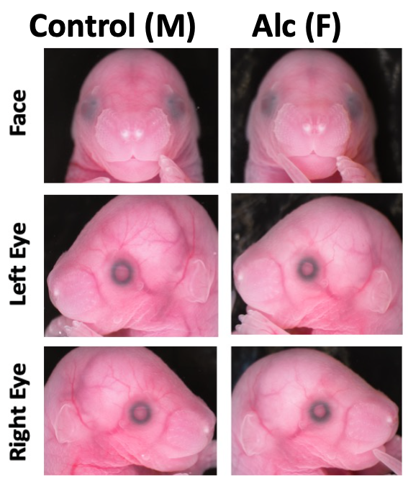
Results and Conclusions
C57BL/6J mice have a higher rate of defects than 129S1/SvImj mice when exposed to alcohol
We found no eye or craniofacial defects in any of the crossed fetuses, though alcohol treated litters were smaller in weight on average
These findings suggest that that crossing alcohol-resistant 129S1 mice with alcohol-susceptible 6J mice confers some genetic protection against development effects of alcohol
Future development will include creating an F₂ generation of the cross, as well as comparing the RNA-sequencing data of the two parent strains
Above: Representative images of control and alcohol-treated C57 fetuses. In alcohol treated offspring, serious defects of the eye, philtrum, palate, and brain were found (indicated by arrows).
Above: Representative images of control and alcohol-treated C57x129S1 cross fetuses. There are no defects in either treatment group.

