Slide 1
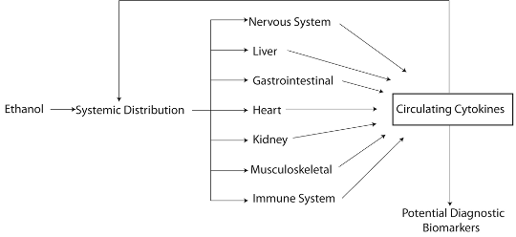
Systemic inflammatory biomarkers and behaviors related to alcohol abuse
Anabel Zaldivar
B.S. Biology
PI: charlotte a. Boettiger PH.D.
Department of Psychology & neuroscience

Slide 2
My research question and purpose was to investigate how could alcohol misuse affect the levels of pro-inflammatory cytokines in the subjects’ blood. Would the high levels of this cell-signaling molecule cause any physical or mental health problems?
My research question is important because it can lead the way for future approaches to understanding the lasting and immediate effects of alcohol misuse in the body starting from a molecular level.

Slide 3
After looking at different correlations and analysis comparing drinking patterns and cytokine levels in the blood, no assumption can be made that one alters the other. There was also no significant difference between moderate and heavy drinkers. The only measure obtained that was shown to be related to cytokine concentrations in the blood was higher emotional states of depression.
My results are important to the research community because by showing no correlation between cytokine and alcohol, there is an open floor to work on this project again while also looking at the effects on emotional states once again.
My results are important to the general audience because it increases awareness for negative effects of alcohol misuse on depression levels, mostly due to neuroinflammation.

