Slide 1
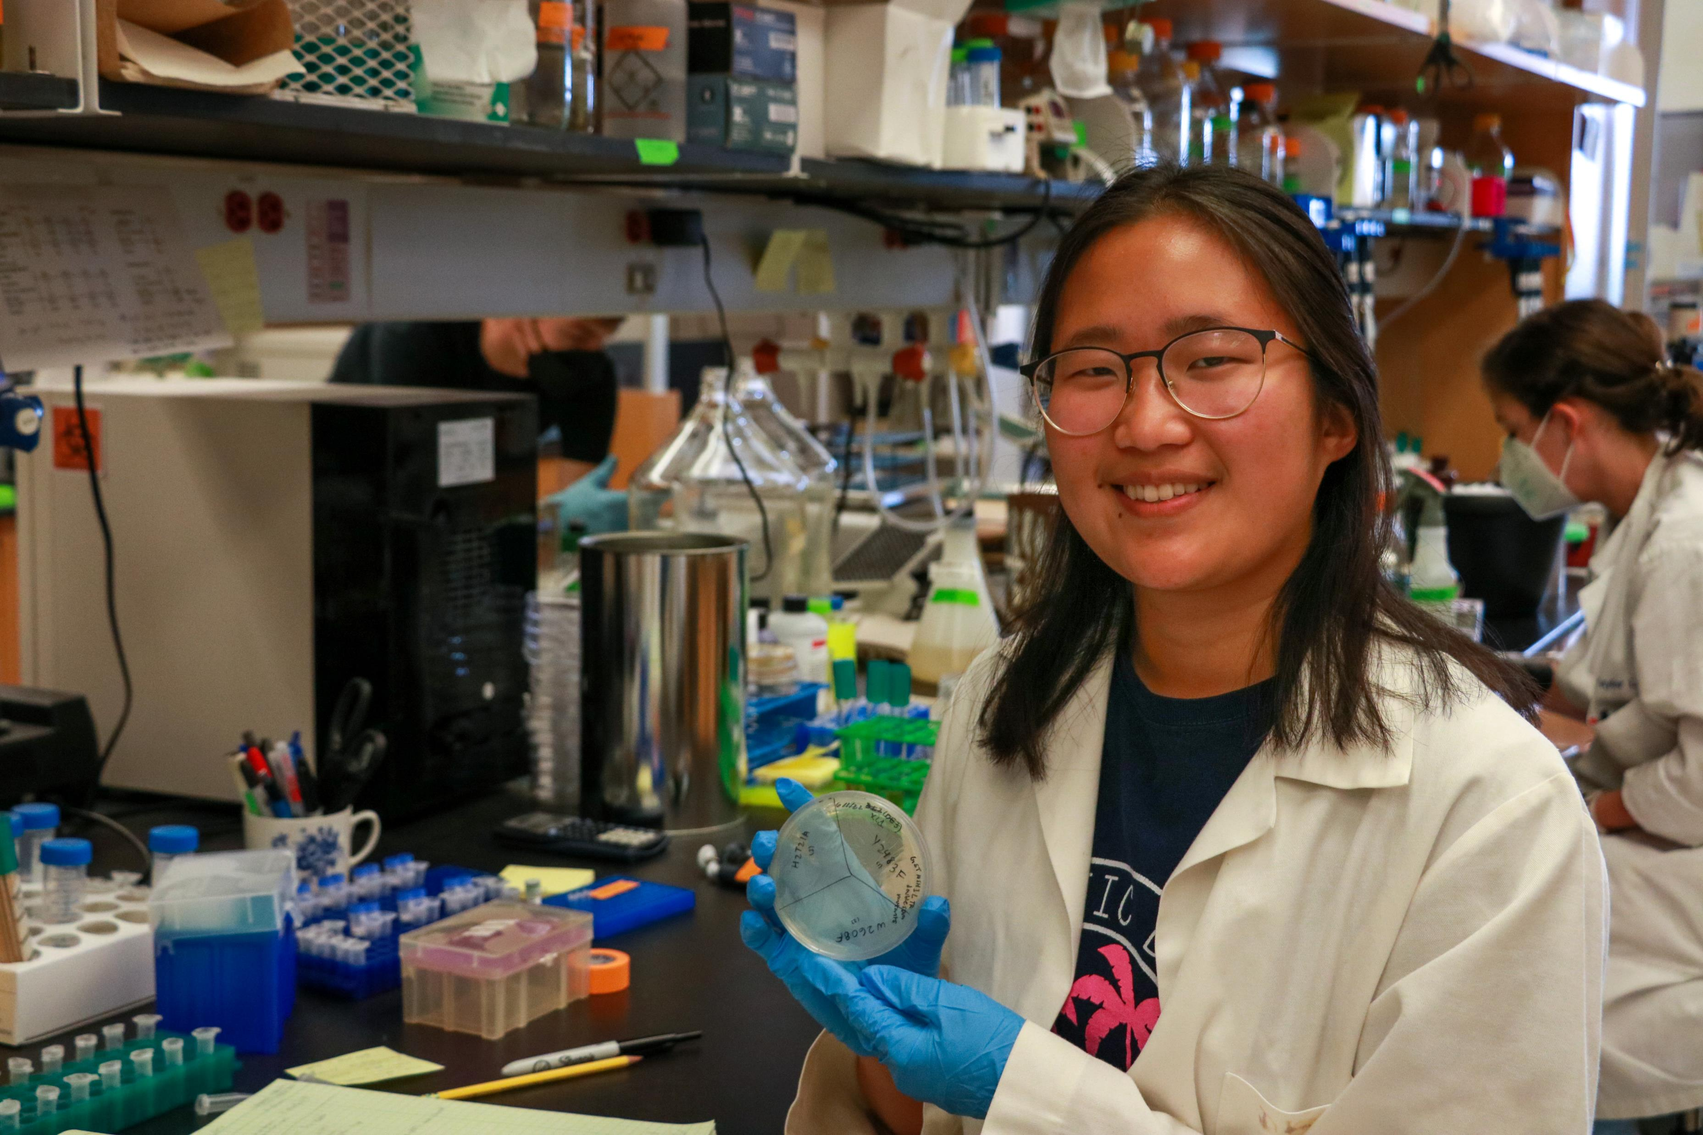
Determining the Histone Post-translational Modification Binding Specificities of ASH1L Histone Reader Domains
Tiffanie Lee
Quantitative Biology
Dr. Brian Strahl, Department of Biochemistry and Biophysics

Slide 2
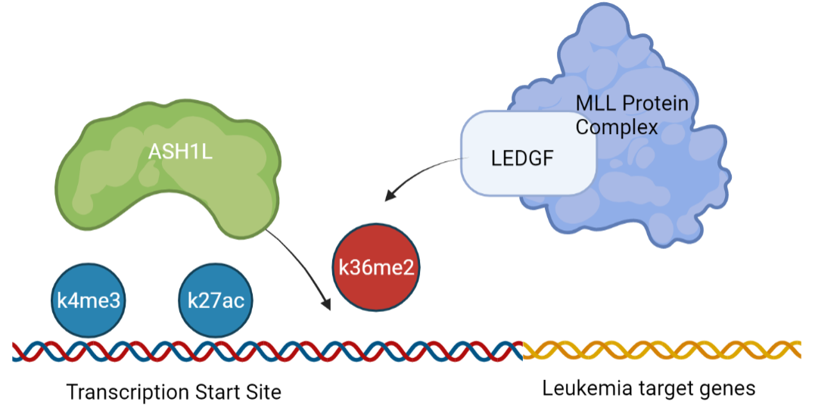
How does ASH1L read chromatin? What histone reader domains are involved in binding?
ASH1L and MLL cooperate to maintain hematopoiesis and transcription in immune cells in the blood
Mixed-lineage leukemias result from chromosomal translocations. These cases are frequently acute and may be resistant to chemotherapy, resulting in poor outcomes, esp. for children
Inhibiting ASH1L binding can potentially treat MLL-rearranged leukemias
Hypothesis: The BRD, BAH, and PHD domains are involved in binding to two post-translational modifications

Slide 3
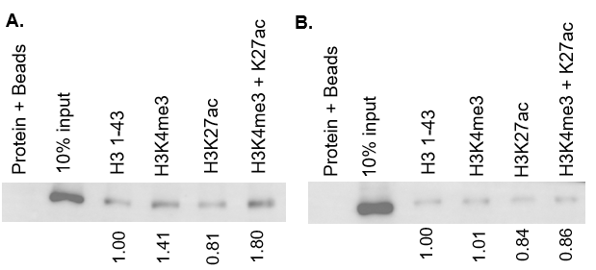
Results
1. Successfully made mutant constructs of GST-ASH1L mutants in histone reader domains using site directed mutagenesis
2. Affinity purified single mutants and triple mutant
3. Confirmed binding of ASH1L TR on H3 peptides with peptide pulldown assays
Future directions:
Reconfirm sequencing and troubleshoot issues with creating single point mutant constructs
Determine binding specificities of single- and double-point mutants
Test on nucleosomes, human embryonic kidney cells
1.
2.
BRD PHD BAH TSDM
3.
BRD^{pm} PHD^{pm} BAH^{pm}

